Slide 1
Approach to Database Design
Course 4: Week 4: RDBMS

Slide 2
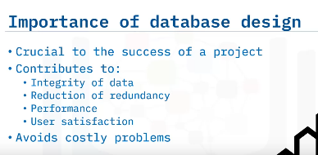
Approach to Database Deisgn including ERD (Entity Relationship Diagram)
a

Slide 3
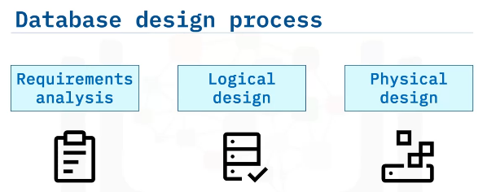

Slide 4
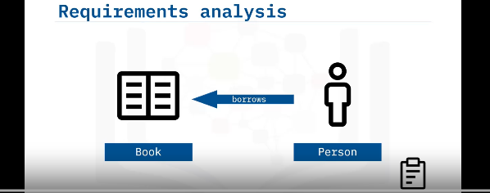
Designing a database for a ‘Library Scenario’
Suppose a person borrows a book

Slide 5
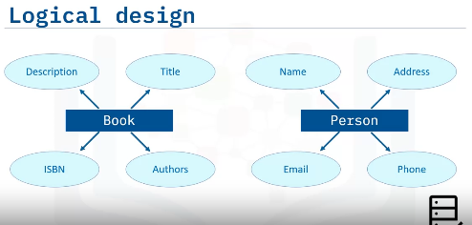
Try to think about attributes and entities. Do not have to worry about technical aspects to include initial ERD design.
We can take support from team members or previous projects to refer what could be possible as a data entities and expand on attributes.
Think with Normalization in mind, so that we can split the tables from the get go.

Slide 6
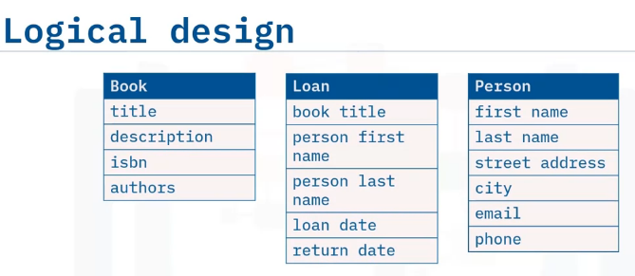
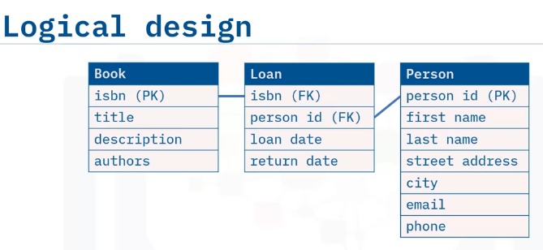
One person can borrow one or many books as it is one-many relationship.
One person can loan multiple books or loan a single book many times.
PK & FK
Most OLTP systems are normalized to the 3NF (third normal form) for optimal transactional performance.
Whereas OLAP systems are generally denormalized to enhance read performance.
OLTP: On-Line Transactional Processing
OLAP: On-Line Analytical Processing

Slide 7
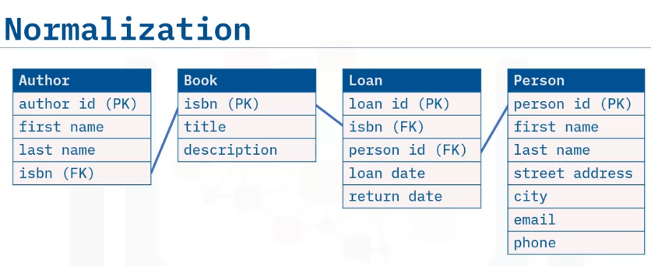
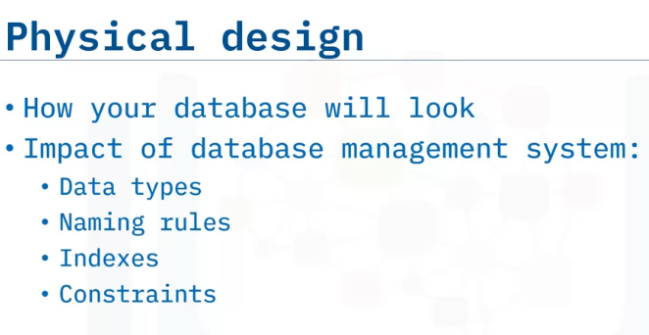
Creating a separate ‘Authors’ entity as there could be many author for a single book.
(1-Many relationship)

Slide 8
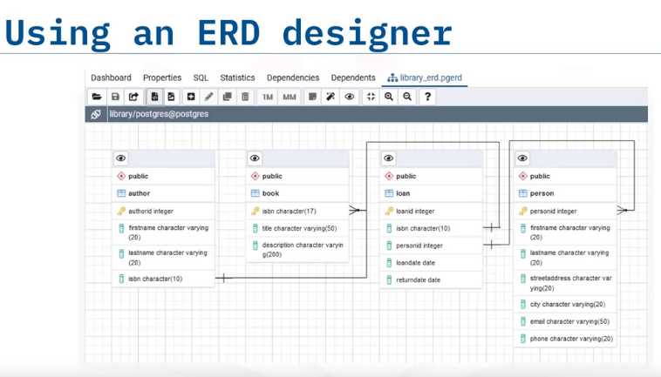

Slide 9
